Slide 1

Representation Powers
and
Mandates
RPaM
DIGIT
Working Group Meeting
10th January 2019

Slide 2

Agenda
RPaM Working Group Meeting #1
Content
Round-table
The project (introduction) (Rui Venâncio)
Meeting objectives (Rui Venâncio)
Glossary (Enric Staromiejski)
Use Cases and Scenarios (Enric Staromiejski)
The RPaM Ontology (Enric Staromiejski)
How to cooperate (Laia Bota)
Next WG sessions (Rui Venâncio)
Questions and suggestions (WG members)

Slide 3
1
Round
Table

Slide 4


1
Round Table
DIGIT and MS
everis team
European Commission
Miguel Álvarez-Rodríguez (DIGIT, project owner)
Frédéric Poels (DIGIT, project owner)
Carlos Gómez-Muñoz (DG CNNECT, project owner)
Valentin Mesaros (DIGIT, analyst)
Member States and Stakeholders:
everis
Virginia Gomáriz (client manager)
Rui Venâncio (project manager)
Enric Staromiejski (eGovernment and interoperability)
Laia Bota (semantics analyst)
Danae Djin Ah Armelle Desplanques (business analyst)

Slide 5
Next
WG
sessions
2

Slide 6
2
The project (introduction)
Isa² Programme Action 2016.12 “Semantic Interoperability for Representation Powers and Mandates. (DIGIT with support of CNECT).
Seeks to create a shared European data model for Representation Powers and Mandates creating a common semantic framework.
Project from March 2018 to April 2019 divided in three phases
Phase 1: MSs' preparedness for cross-border interoperability
Phase 2 with three main tasks:
Analisys of already existing electronic Mandate systems and data models in Austria, Belgium, Finland, The Netherlands, Portugal and Spain.
Definition of the solution to the main cross-order interoperability challenges.
Detailed description of the cross-border scenarios
Phase 3:
Share all findings and collect the feedback and discuss with WGs.
Resulting in a mature date model

Slide 7
3
Meeting objectives

Slide 8
3
Meeting objectives
Discuss the project reports: use cases, solutions, difference between Powers and Mandates
Present the first conceptual model proposal and start first discussions
How the WG will be able to access the information in Github
How to interact and communicate in the context of the Working Group

Slide 9
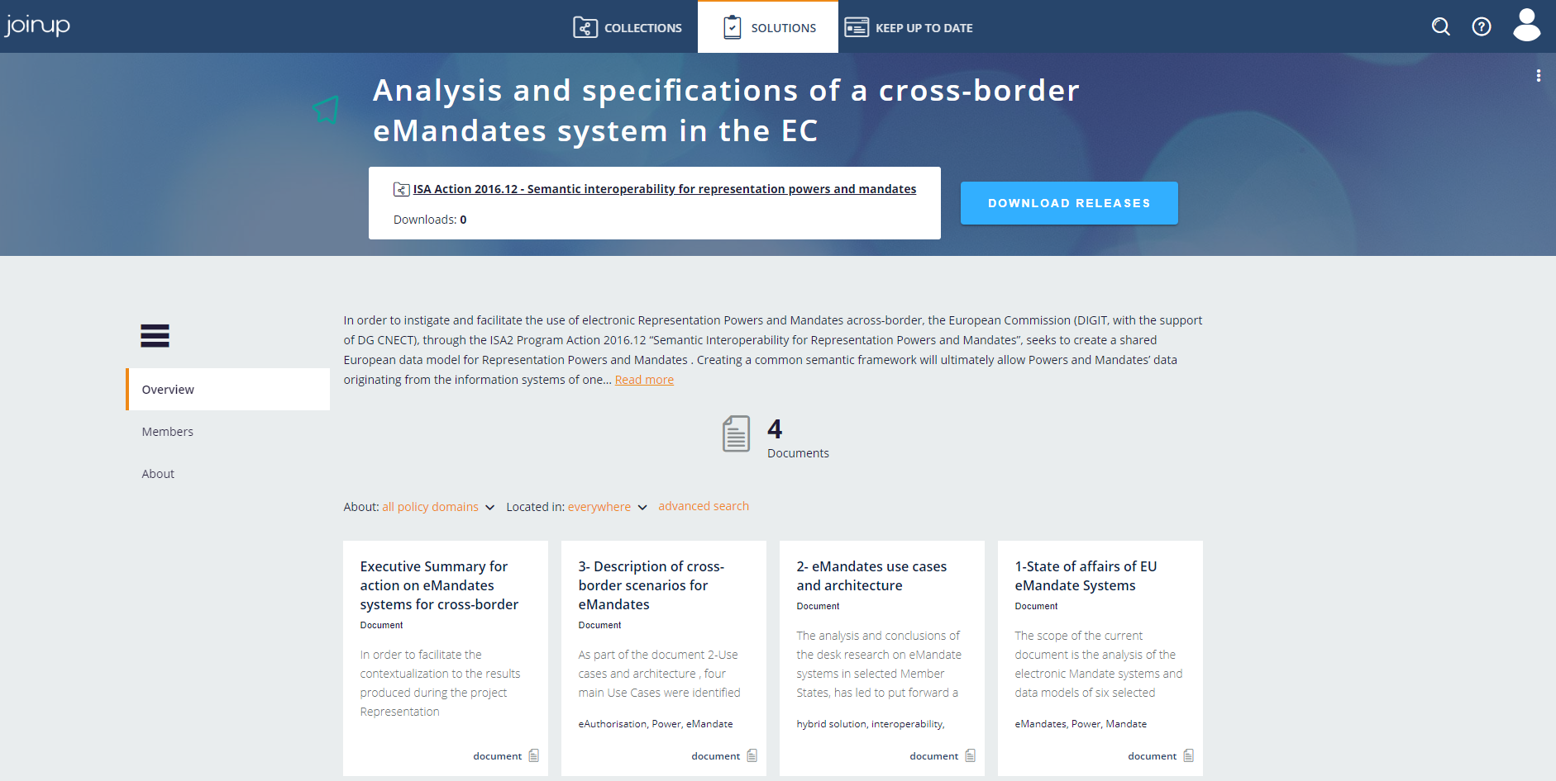
Introduction
Webminar Inputs
https://joinup.ec.europa.eu/solution/analysis-and-specifications-cross-border-emandates-system-ec

Slide 10
4
Glossary

Slide 11
4
Glossary
Power: the legal capacity, right or privilege to act.
ePower: an eDocument that a natural person has the legal capacity, the right or the privilege to access a Service Provider System. ePowers are evidences.
Mandate: contract under which an entity (Mandatee) undertakes to perform one or more legal acts in the interest of another person (Mandator).
eMandate: an eDocument that proves that a Mandatee has been assigned one or more Powers of a Mandator. eMandates are evidences
Mandator: natural or legal person who needs an activity executed in his name; creator of the Mandate. Synonyms to this term can be: “principal”, “assignor”, “represented”.
Mandatee: natural or legal person who executes an activity in the name of the Mandator; user of the Mandate. Synonyms to this term can be: “proxy”, “assignee”, “agent”, “representative”.
eBusiness Document: a set of interrelated information representing the facts, data, or opinions, in any medium or form, including textual, numerical, graphic, cartographic, narrative, or audio-visual forms that the capability exchanges with other capabilities to support the execution of value streams.
Service Provider: An organisation, public or private, that provides an online service, e.g. a Public Administration's online service that requires the electronic identification of the user and, in the case of a person acting on behalf of another person, the information needed for the authorisation to access the service based on an eMandate.
eMandate Registry: the system where eMandates are created and stored.

Slide 12
Use Cases
and
Scenarios
5

Slide 13
5
Use Cases
Use Case 0 – Cross-border User eAuthorisation (i.e. on behalf of oneself)
“A natural person16 wants to use on his/her behalf a service that is in another EU MS”.
Use Case 1 – Cross-border Mandatee eAuthorisation
“A Natural Person in MS-A, acting on behalf of another Natural or Legal Person, wants to access a Service that is in MS-B”.
Use Case 2 – Creation of an eMandate
“A Person in MS-A wants to create an eMandate to empower one or more Persons that is in MS-B to access one or more Services on her behalf”.
Use Case 3 – Delegation of Powers
“A Mandatee, with the Power to delegate35, assigns the Power of the Mandator to another Mandatee”.

Slide 14
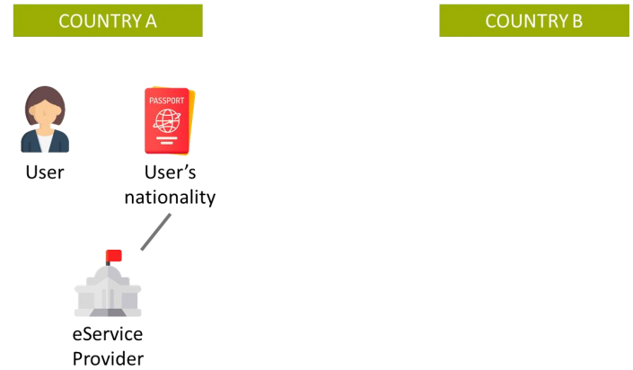
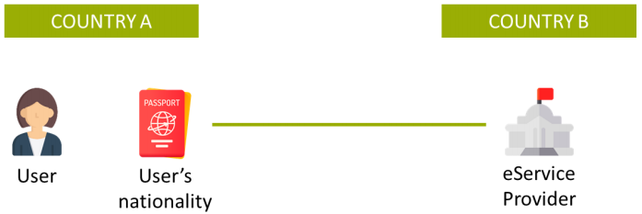
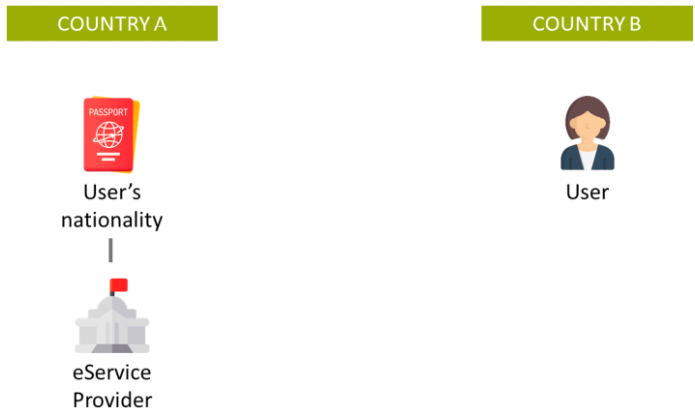
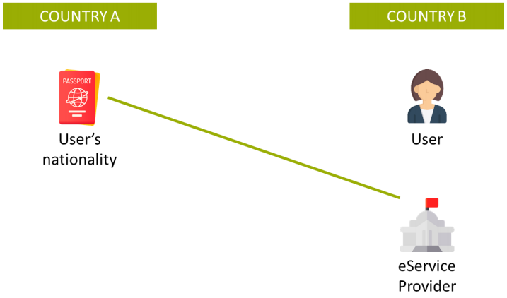
5
Use Case 0 Scenarios
A French person, residing in France, is requesting online access to a French Service → No cross-border interoperability.
A French person, residing in France, is requesting online access to a Spanish Service
A French person, residing in Spain, is requesting online access to a French Service → No cross-border interoperability.
A French person, residing in Spain, is requesting online access to a Spanish Service.

Slide 15
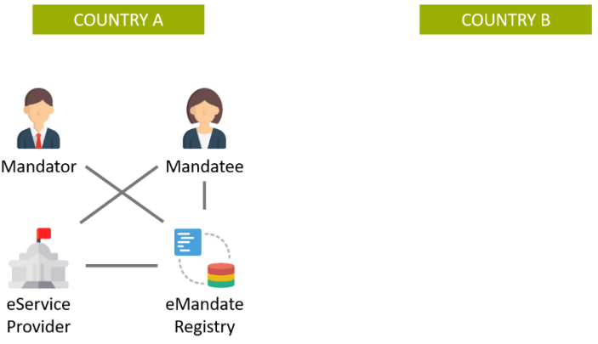
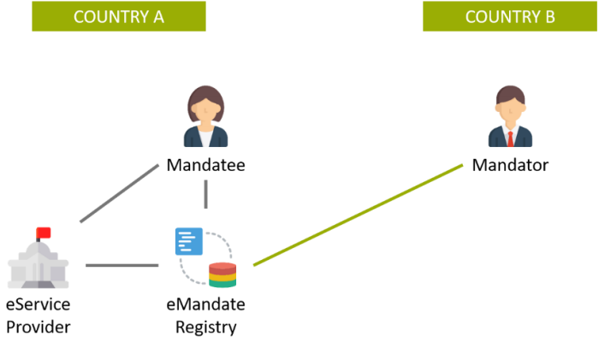
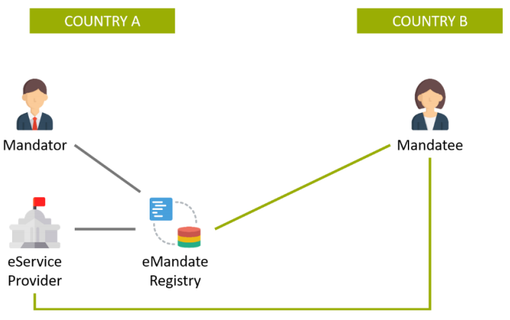
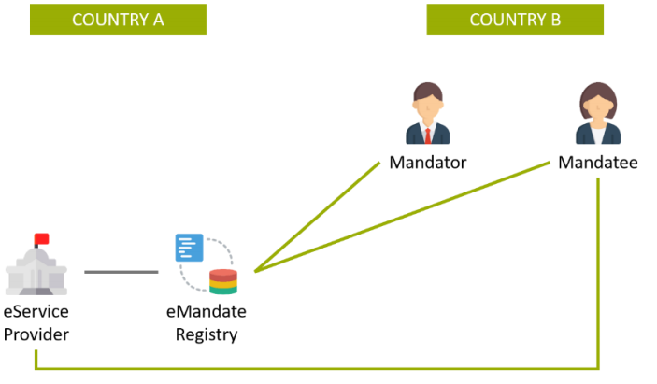
5
Use Case 1 Scenarios
A French Person uses a French eMandate Registry to create an eMandate and empower another French Person to access online to the system of a French Service Provider → No cross-border interoperability.
A French Person uses a Danish eMandate Registry to create an eMandate and empower a Danish Person to access online to the system of a Danish Service Provider. This situation implies that a French Person can use a Danish eMandate Registry to create an eMandate.
A German Person uses a German eMandate Registry to create an eMandate and empower an Austrian Person to access online to the system of a German Service Provider. This situation implies that a German eMandate Registry can recognize a Mandatee from another Member State, for example if the Mandatee is a Legal Person registered in another country.
A Portuguese Person uses a Greek eMandate Registry to create an eMandate and empower another Portuguese Person to access online to the system of a Greek Service Provider. This situation implies that a Greek eMandate Registry can recognize a Mandator and a Mandatee from another Member State.

Slide 16
The
RPaM
Ontology
6

Slide 17
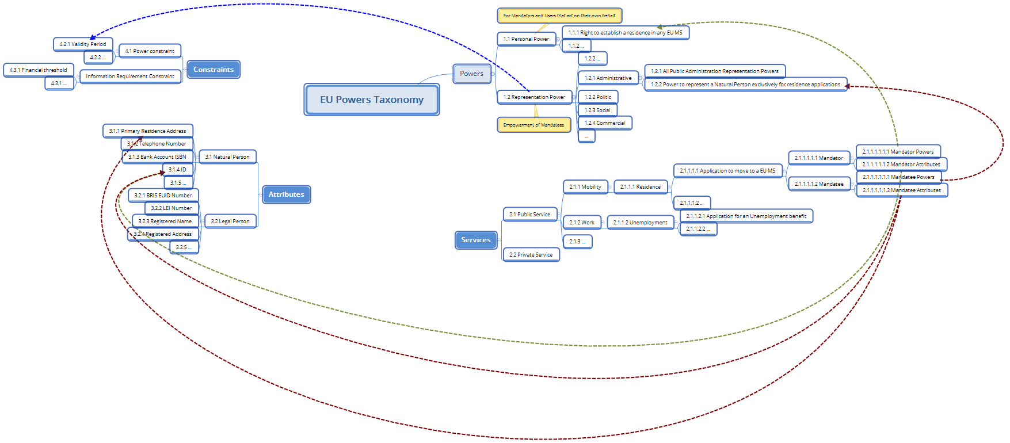
6
The RPaM Ontology – General Approach

Slide 18
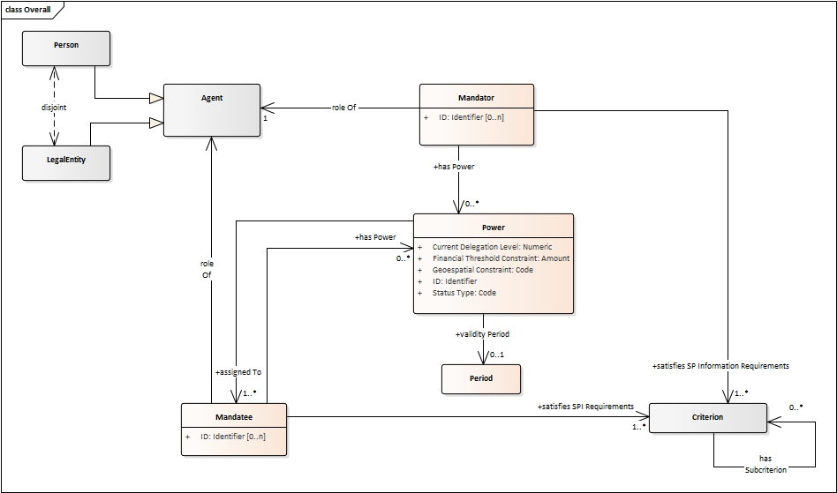
6
The RPaM Ontology

Slide 19
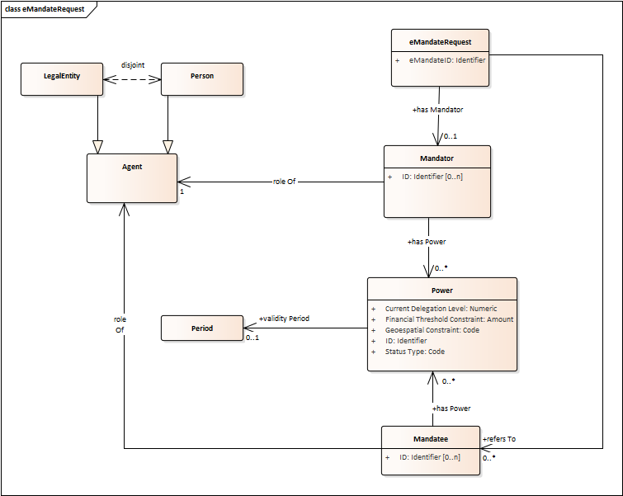
6
RPaM eBusiness Documents (1/4)

Slide 20
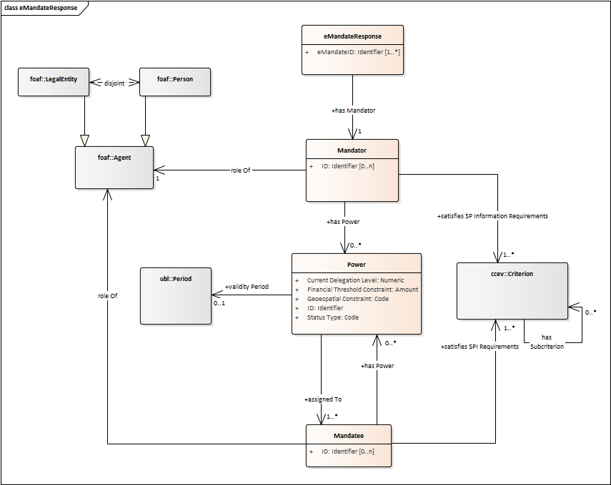
6
RPaM eBusiness Documents (2/4)

Slide 21
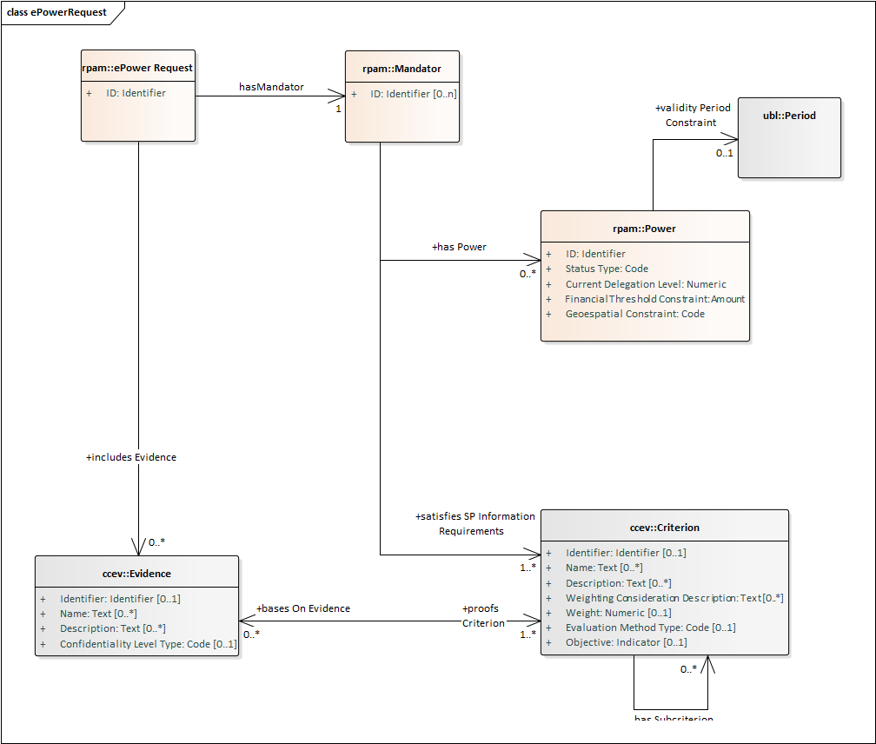
6
RPaM eBusiness Documents (3/4)

Slide 22
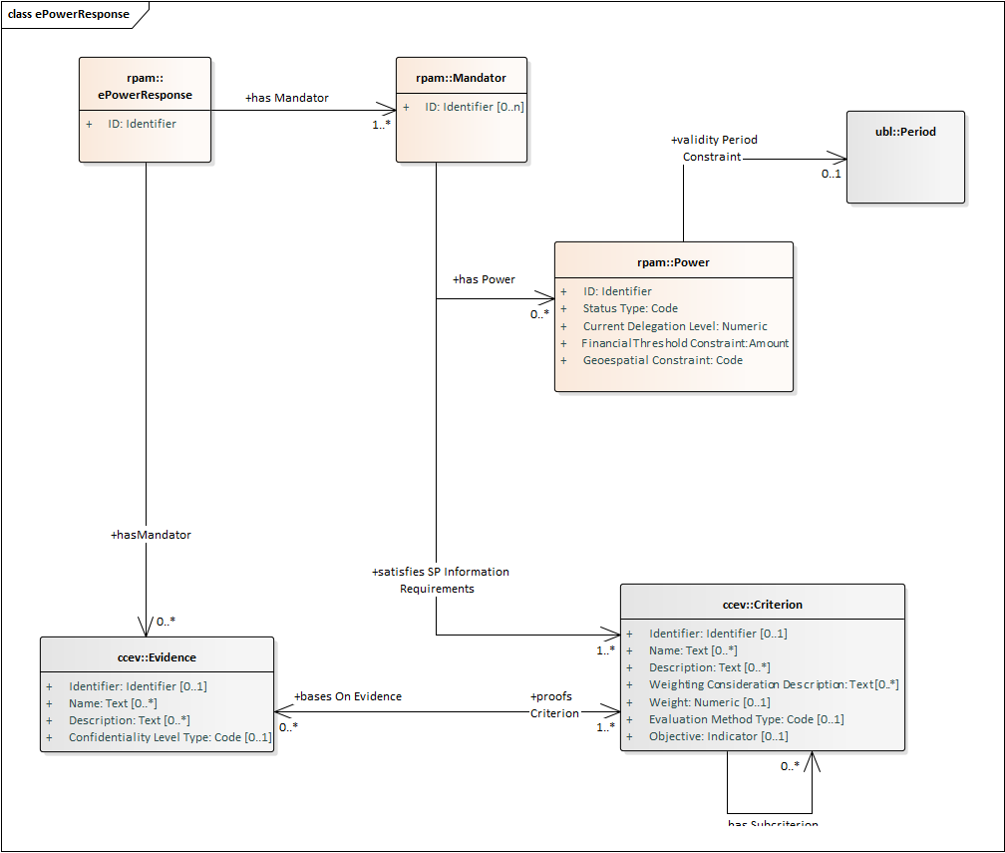
6
RPaM eBusiness Documents (4/4)

Slide 23
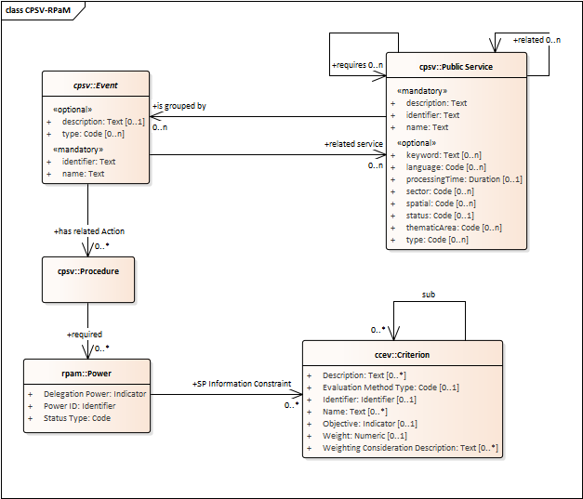
6
Reused ontologies (CPSV-AP RPaM)

Slide 24
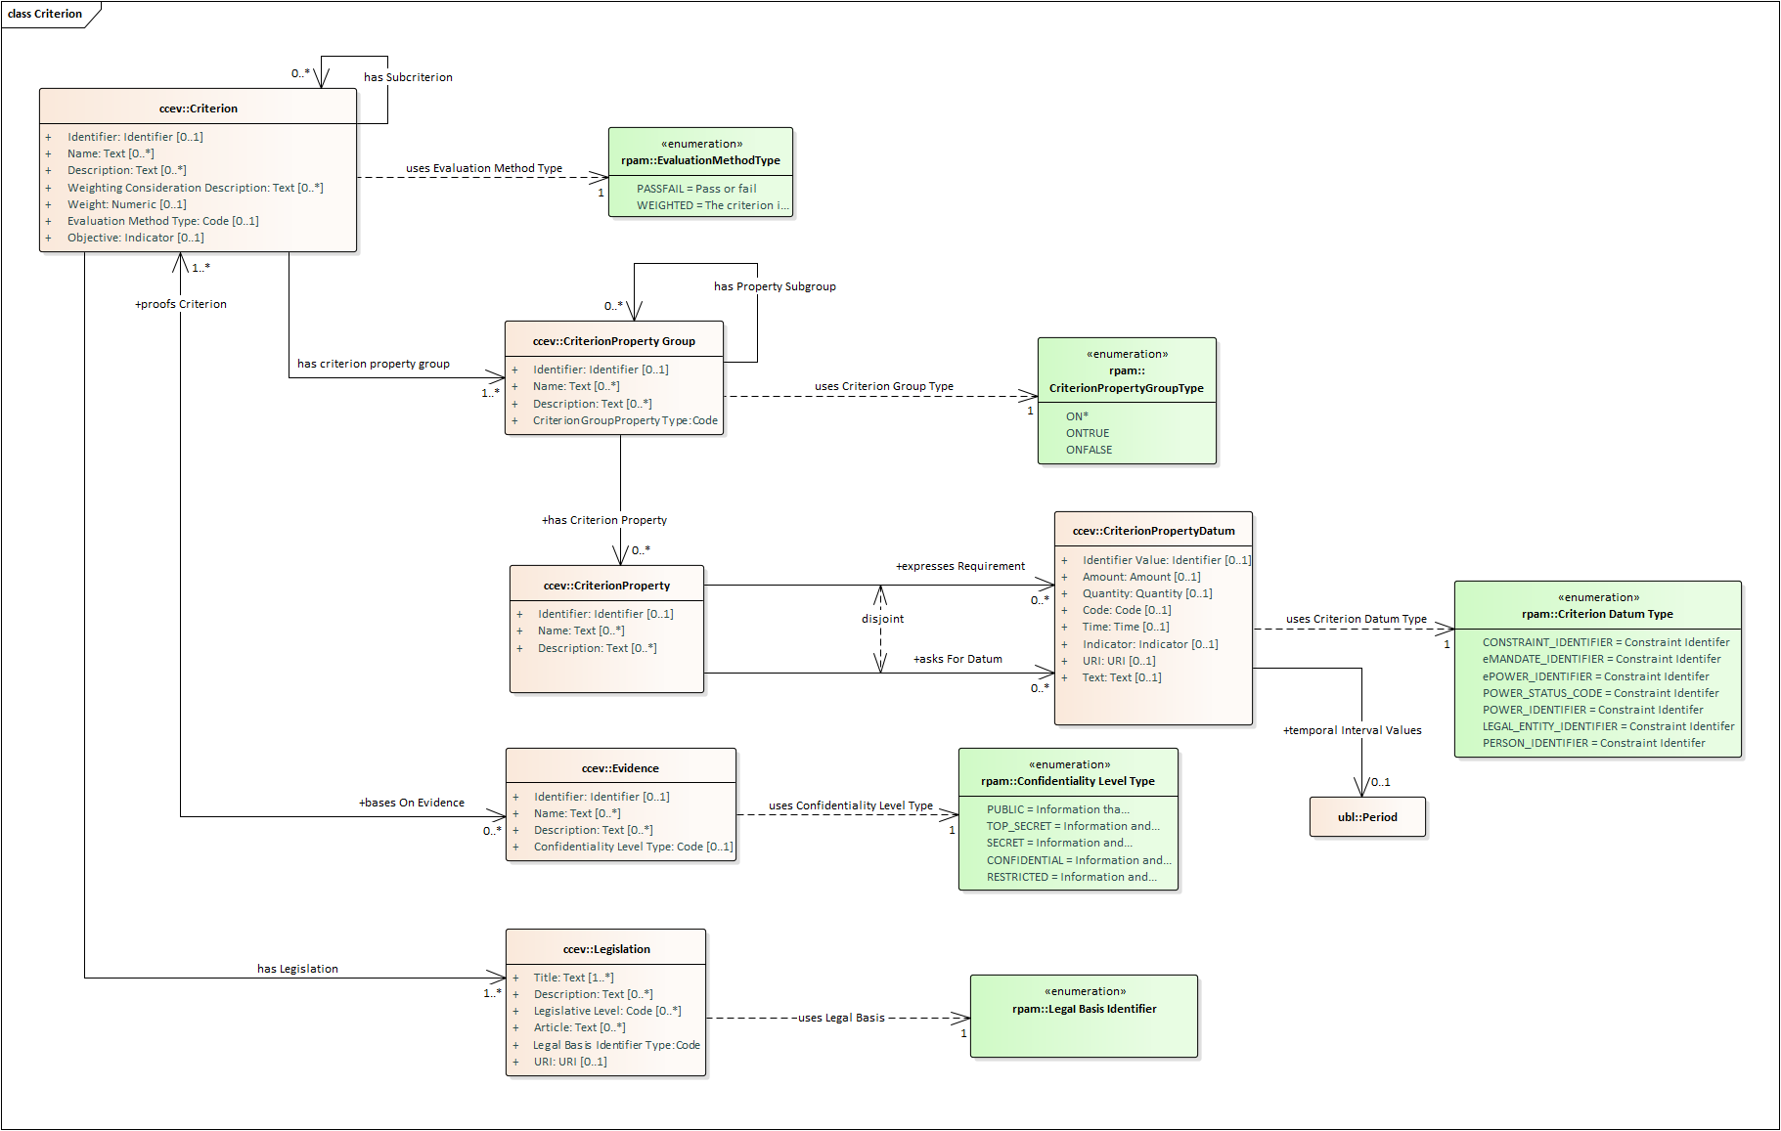
6
Reused ontologies (CCEV)

Slide 25
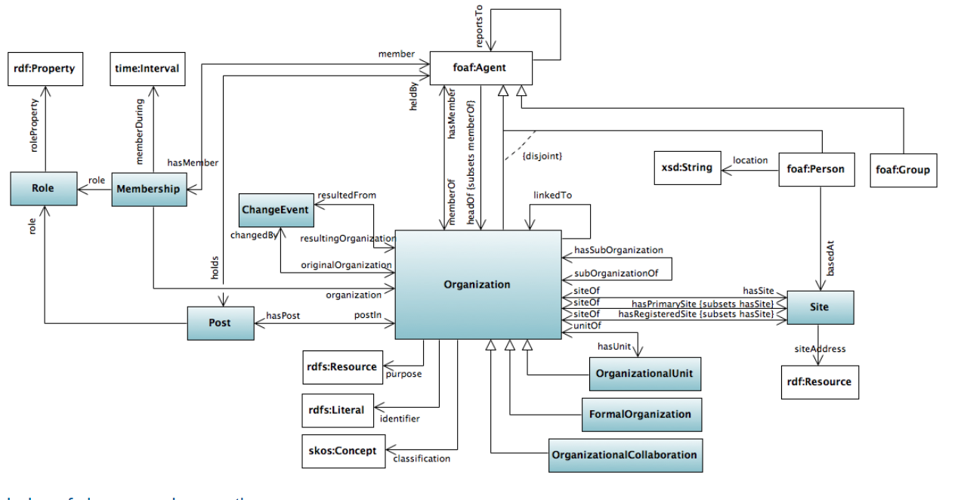
6
Reused ontologies (W3C Organization)

Slide 26
How
to
cooperate
7

Slide 27
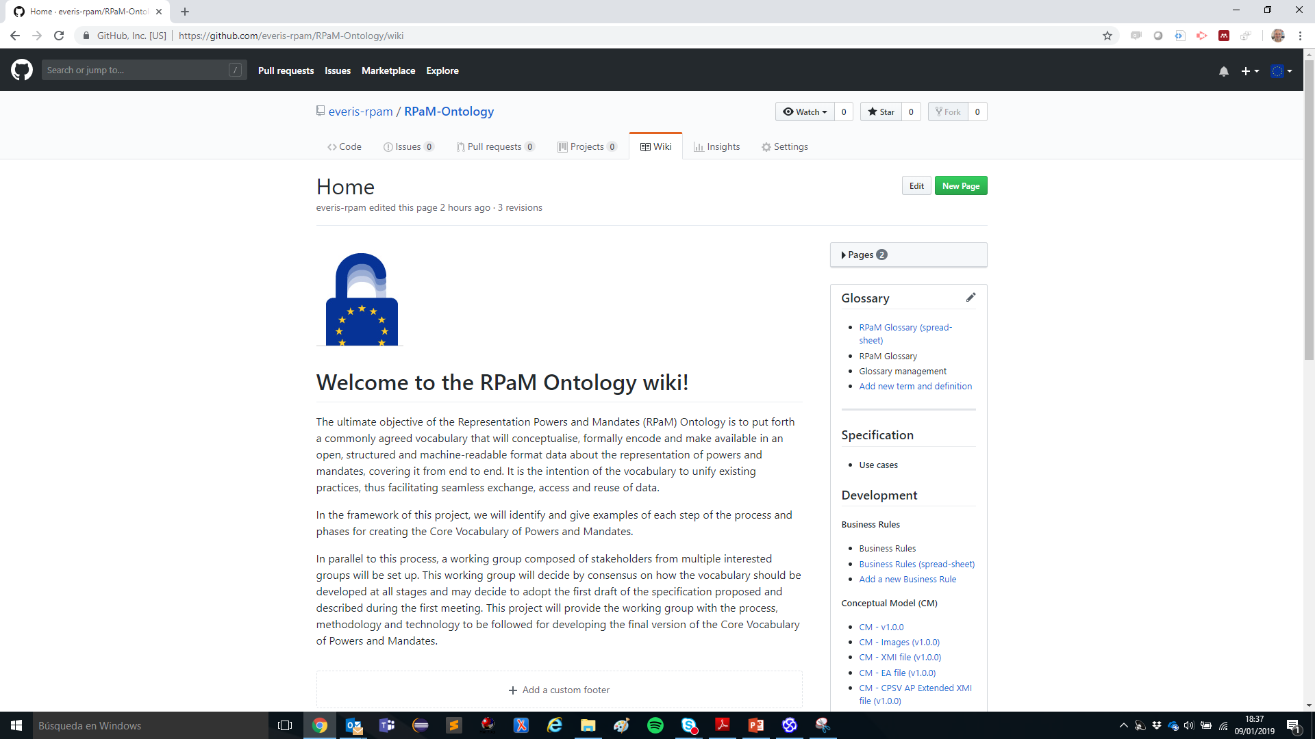
7
How to cooperate
https://github.com/everis-rpam/RPaM-Ontology/wiki
https://github.com/everis-rpam/RPaM-Ontology/wiki

Slide 28
Next
WG
sessions
8

Slide 29
8
Next Working Group sessions
Next webinars
31st January 21st February 14th March 4th April
Communication
GitHub Issues rpam-wg@everis.com

Slide 31
Sample questions
1- Is there any situation where the eMandate (or ePower) would not aim to trigger an eAuthorisation?
2- Is it possible to come up with a set of “harmonised public services?” What would these be? SDGR-based?
3- Would it be possible for a MS to rely on a simple eAuthorisation “OK/KO” returned from the cross-border eMandate Registry, at least for the “harmonised” public services?

